Slide 1

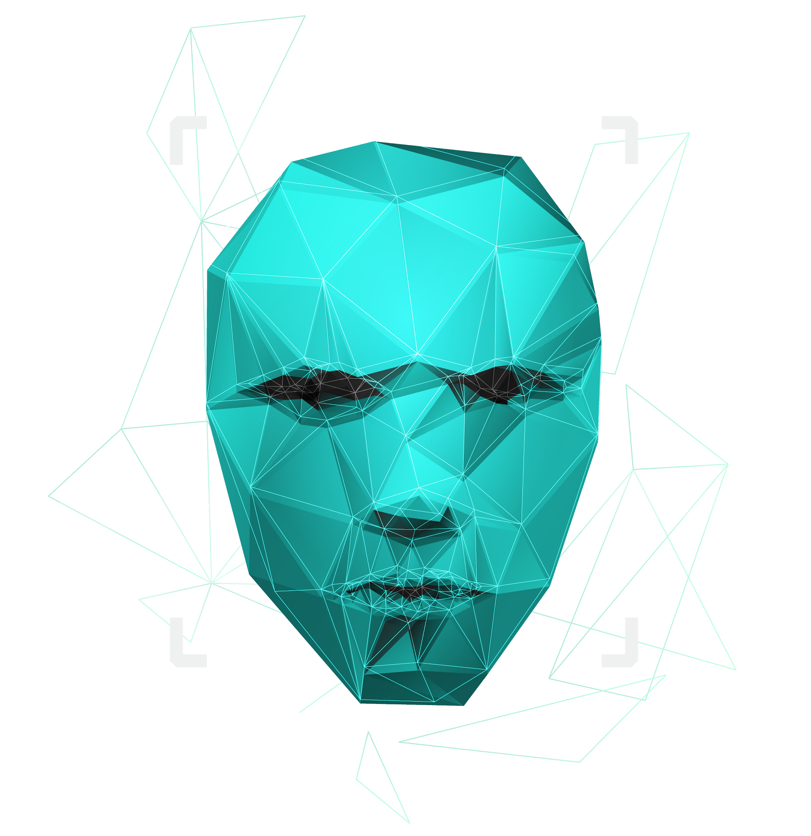
TRIBE - I
LEAPACADEMY

Slide 2

MEMBERS OF THE TRIBE
HARDEEP SINGH
RINKY KOHLI
LIPSA
ABHINAV MANI TRIPATHI
SHAUNAK BISWAS
PARTH SHARMA
ASHUTOSH NAIK
TANYA SINGH
REPALLE NAGASAI
JAINEEL PETIWALE
UMA PRASAD DAS
HARDEEP

Slide 3

DATA SCIENCE
DEFINITION
IMPORTANCE
Data science is a field of study that combines domain expertise programming skills and knowledge of mathematics and statistics to extract meaningful and relevant insights from the data.
Data science helps organizations to associate and rectify target audiences by homogenizing existing data with other data points for emerging useful insights. Data science also help recruiters by merging data points to identify candidates that best fit the company needs.
USES
Data science is used to examine questions which need answering and where to find the related data it is also used to manage and analyze large amounts of unstructured data.
JAINEEL

Slide 4
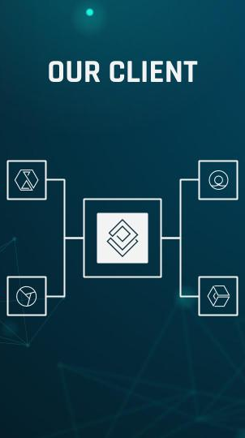
ARTIFICIAL INTELLIGENCE (AI)
Artificial intelligence [AI] is the simulation of human intelligence processes by machines especially computer system. Specific applications of AI include expert systems, natural language processing (NLP), speech recognition and machine vision. Artificial intelligence simulates human intellect to machines. AI-enabled machines are capable of performing specific tasks better than humans and mimic human actions.
RINKY

Slide 5
Who are we helping?
Background:
Mental health situation through out the world
Limitation of the reach of therapists
Digital Age and far reach of smart devices
Stigma related to asking for help
What are we doing:
Initial demographic will be students
Exploring the patterns to better understand human emotions
Can help with over-the-air therapy sessions
A complete package for Doctors to monitor the progress and current state of the Patient.
Added by Parth

Slide 6
PREDICTION OF MENTAL HEALTH ILLNESS
ABHINAV

Slide 7

DATA CLEANING
Data cleaning also known as data scrubbing.
It is a very crucial part to maintain the correct data for business decisions.
The heedless of removal of data errors may cause serious predicament which could result in bad quality, incorrect spelling, wrong data entry, missing information, etc.
Use of techniques such as parsing, correcting, standardizing, matching, consolidating, handling missing and noisy data will meet the requirements needed for solving bigger problems of data cleaning.
SHAUNAK

Slide 8
BENEFITS OF DATA CLEANING
Whenever a Big Data is considered, the analysis of such big datasets are always expensive and difficult to handle.
Therefore, to reduce the corrupted and inconsistent data always aid in easier management of data keeping it in a proper sequence. Such datasets are easy to access and avoids any confusion.
The lesser the incomplete and incorrect data provided by the company or industry, the happier will be the clients. The same also ensures the less work-load on employees. Mapping of data and its functions to minimize the compliance risks and the threats related to data hacking and cyber/ malware attacks.
Use of tools and techniques involved in data cleaning is an efficient way to allow improved decision making. Such data comes up with boost results and revenue. Removal of duplicate copies supports extra space, reduces waste and saves money.
SAI

Slide 9
WHY IS IT NEEDED?
Monitor errors
Standardize your process
Validate data accuracy
Scrub for duplicate data
Analyze your data
Communicate with your team
LIPSA +PARTH
+UMA

Slide 10
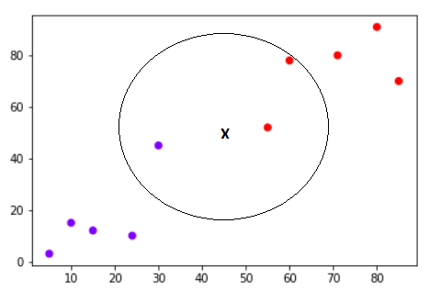
ML ALGORITHM
In statistics, the k-nearest neighbors algorithm (k-NN) is a non-parametric classification method first developed by Evelyn Fix and Joseph Hodges in 1951, and later expanded by Thomas Cover. It is used for classification and regression. In both cases, the input consists of the k closest training examples in data set.
ASHUTOSH

Slide 11
Target Clients/Our Aim
- Government
- Corporations and Companies
- Schools and educational institutes
- Hospitals and Clinics
Added by Parth

Slide 12
CONCLUSION
I will conclude the whole ppt (Tanya)

Slide 13
THANKS!
Do you have any questions?
youremail@freepik.com
+91 620 421 838
yourcompany.com
Please keep this slide for attribution.

